Slide 1
DEPARTMENT OF COMPUTER SCIENCE AND ENGINEERING
Essay Meter
Deep Learning
Team Members
Name | Roll number
Vishwak Senan G | 201601110
Sundaramoorthy T | 201601100
Pranav Kumar K | 201601074
Team Supervisor
Name | Designation
Ms Dr D Jayashree | Assistant Professor
Zeroth Review : 01-10-2019

Slide 2
Objective of the Project
The primary objective of this project is to evaluate a given essay’s various parameters and help people to improve their English writing skill.
The objective is achieved by providing a platform – web application – for our users to evaluate and maintain log for their texts.
We use multiple trained neural network modals to evaluate various aspects of the essay and produce an overall score on a scale of 0-10 where 0 is the lowest and 10 is highest.
Our project targets the audience who are looking to evaluate their essays. For example, a person who is looking to take Graduate Record Examination (GRE) can use our platform to improve their score in Analytical Writing Assessment (AWA) section.
We also plan to make our whole product as a service where other platform can integrate our service to their platform using an API key of our service. The service will be hosted on any existing cloud architecture like Amazon Web Services (AWS), Google Cloud Platform (GCP), Microsoft Azure, etc,.

Slide 3
Introduction
The project <project_name> is a product which gives linguistic support to all our users and enhance their English writing skill.
To integrate our primary feature in other software, we host our primary service in cloud architecture and use our API keys to access it securely.
<project_name> also provides an attractive dashboard to our users to keep track of their scores and their essays.
We evaluate the essay on these parameters.
Style continuity.
Coherence and cohesion.
Advanced lexical resources.
Grammatical range and accuracy.
Sentence complexity.
The number of parameters used will increase in the future to provide a micro evaluation of the essays.
<project_name> will have plagiarism feature to check the authenticity of the essay.

Slide 4
Project Feasibility Study
We achieve our feature extraction goal using multiple trained neural network models where each model will do a particular task.
Programming language: Python
We have several international journals as reference to support our feasibility of our project within the speculated time. The journals are explained further in Literature Survey.
Framework:
Python Web Framework:
Django
UI Frameworks:
Bootstrap
React JS
JQuery
Chart JS
Python Package:
Tensorflow
Pandas

Slide 5
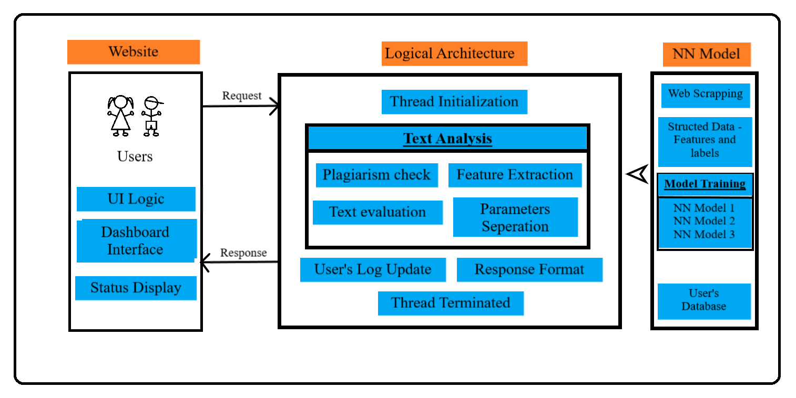
Architecture of <project_name>

Slide 6
Literature Survey
With the support of several concepts used in the international journal and my own ideas will lead to successful implementation of the project.
We use primary features of 2 international journals
Text Classification using Different Feature Extraction Approach
Analysis of Text Categorization Represented With Word Embeddings Using Homogeneous Classifiers
Paper 1 uses Term Frequency Inverse Document Frequency (TF-IDF) weighing scheme to extract feature’s advantage and uses Latent Semantic Analysis (LSA) and Linear Discriminant Analysis (LDA) to overcome TF-IDF’s disadvantage.
Paper 2 uses Word embeddings and ensemble strategies to classify text with much higher accuracy. Word embedding dual neural network word2vector model to map words to real time integers according to syntax and semantic relativity. Ensemble strategies uses voting system to choose a model which provides much more accuracy and training time.

